Slide 1
Employment Regulation Strategies for the Modern Workplaces and Global Economy
Thomas A. Kochan
MIT Sloan School of Management
And
Institute for Work and Employment Relations
ESRC Seminar on Regulation of Work and Employment
Newcastle University Business School
March 22, 2014

Slide 2
Overview
The Key Challenges:
Diversity in Workplaces and in the Workforce
Global Scope of Value Chains (where work is done)
Weakening “Countervailing Power” of Unions
Declining Government Resources
Alternative Responses-Public & Private
Beyond National Regulations?

Slide 3
Industrial Model of the Employment Relationship
Large Firm
Long Term Employment
Clear Division of Roles—Management and Employees “Exempt or Non-exempt” in U.S. Parlance
Implicit: Male at Work; Wife at Home…
Union Present or Threat of Union
No Ambiguity Who is the “Employer”

Slide 4
Today’s Realities
Multiple Organizational Forms
Traditional large firms but focused on “core competencies;” fewer broad integrated firms
Work spread through global value chains
Expansion of franchising, contracting, privatizing…
High priority on start-ups and small establishments
Increased Workforce Diversity
Two working parents
Immigrants and migrants
Global options for sourcing work—greater cultural diversity
Diversity of employment rights—sometimes doing very similar work
Weakening of traditional unions; rising roles of NGOs

Slide 5
Challenges
Ambiguity over “Who is the responsible employer?
The sad story of petrochemicals—from Texas to Britain to the Gulf Coast disaster
1989: 22 contract workers killed in Texas chemical plant
2005: BP Texas City plant explosion resulted in 15 deaths
2011: BP, Haliburton, Transocean Deepwater Horizon oil spill—11 killed, Billions of liabilities….but who was the employer?
2013 Bangladesh factory collapse: 1,200+ killed: Who is responsible?
Close to home:
Hotel on MIT land; Leased to Hotel Chain; Options to contract out multiple jobs; and fight over union organizing….who is responsible for controlling management behavior?
U.S. Government Big Buyer of Sweatshop Goods

Slide 6
Factory Collapse, Bangladesh, April 24, 2013: over 1,200 Workers Killed (3,310,000 Google Entries)

Slide 7
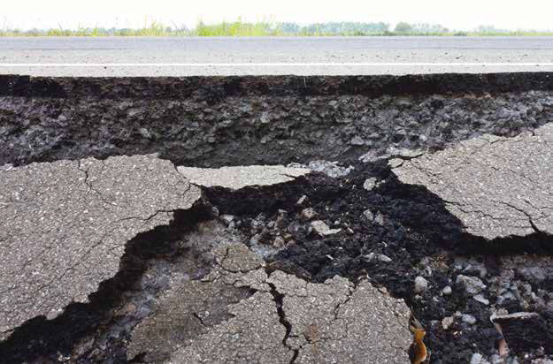
DAV I D W E I L
The Fissured Workplace
WHY WORK
B E C A M E S O B A D
F OR S O M A N Y
A N D W H AT C A N B E D ON E
TO IMP R OV E I T

Slide 8
Toward New Regulatory Strategies: Legislative Updating??
Efforts to define employer as the entity that sets standards for the deliverables—product or service
Revision of “exempt-non-exempt” and/or “management” and “non-management” rules
The U.S.: We will be the last to provide paid family and/or sick leave
And then there is our failed labor law

Slide 9
Alternative Regulatory Strategies: Beyond Command and Control?
Two Track Options—carrots and sticks
Targeting most egregious violators;
Flexibility for how to meet standards for firms with demonstrated records of compliance
Private Institutions—unions, NGOs, community group advocates as complements/allies in enforcement
Identifying points of greatest leverage in value chain “Hot cargo” concept in U.S. labor law
Beyond compliance: technical assistance, advice, best practices, information sharing, etc. for firms to learn how to meet standards and improve performance
Coordination across individual enforcement agencies—common data base of compliance across all employment standards/regulations?

Slide 10
What if this were you???

Slide 11
Regulating Global Value Chains: What we are Learning
Richard Locke, The Promise and Limits of Private Power

Slide 12
Key Elements in an Integrated System for Managing Employment Practices in Global Supply Chains
Corporate Codes of Conduct
Reliable, Credible Auditing Metrics
Transparency—sharing data
Full Disclosure of where products are sourced/produced
Engagement with NGOs
Integrated state-of-the-art operations and HRM practices
Effective enforcement of labor laws
Independent and on-going worker representation
Smoother, predictable procurement patterns
More equitable distribution of profits
Ongoing education, training, and accountability

Slide 13
Next Generation Institutional Complements
Unions
Global Alliances—UNITE; UNI Global Union…
Local Alliances—growing role in U.S.
NGOs
Traditional arms length expose’ role
Growing role in auditing/engaging employers
International Agencies
Is the ILO stepping up????—Cambodia; Bangladesh?
Large MNCs
European firms more willing to work with multi-stakeholder consortia, including unions
Transparency and reporting: Nike: http://www.nikeresponsibility.com/
Industry Associations

Slide 14
Necessity and Invention
No single solution in place
Need era of experimentation and learning
Need for renewed government leadership
Will the U.S. Department of Labor be reborn???
Will the U.S. government become a responsible purchaser-contractor and use its leverage?
Will we update the full range of labor and employment policies to catch up with the changing workforce and workplaces?
Work-family policies
Wage and hour policies
Labor law and policies
And a lot more…..needed and perhaps to come some day!

